Slide 1
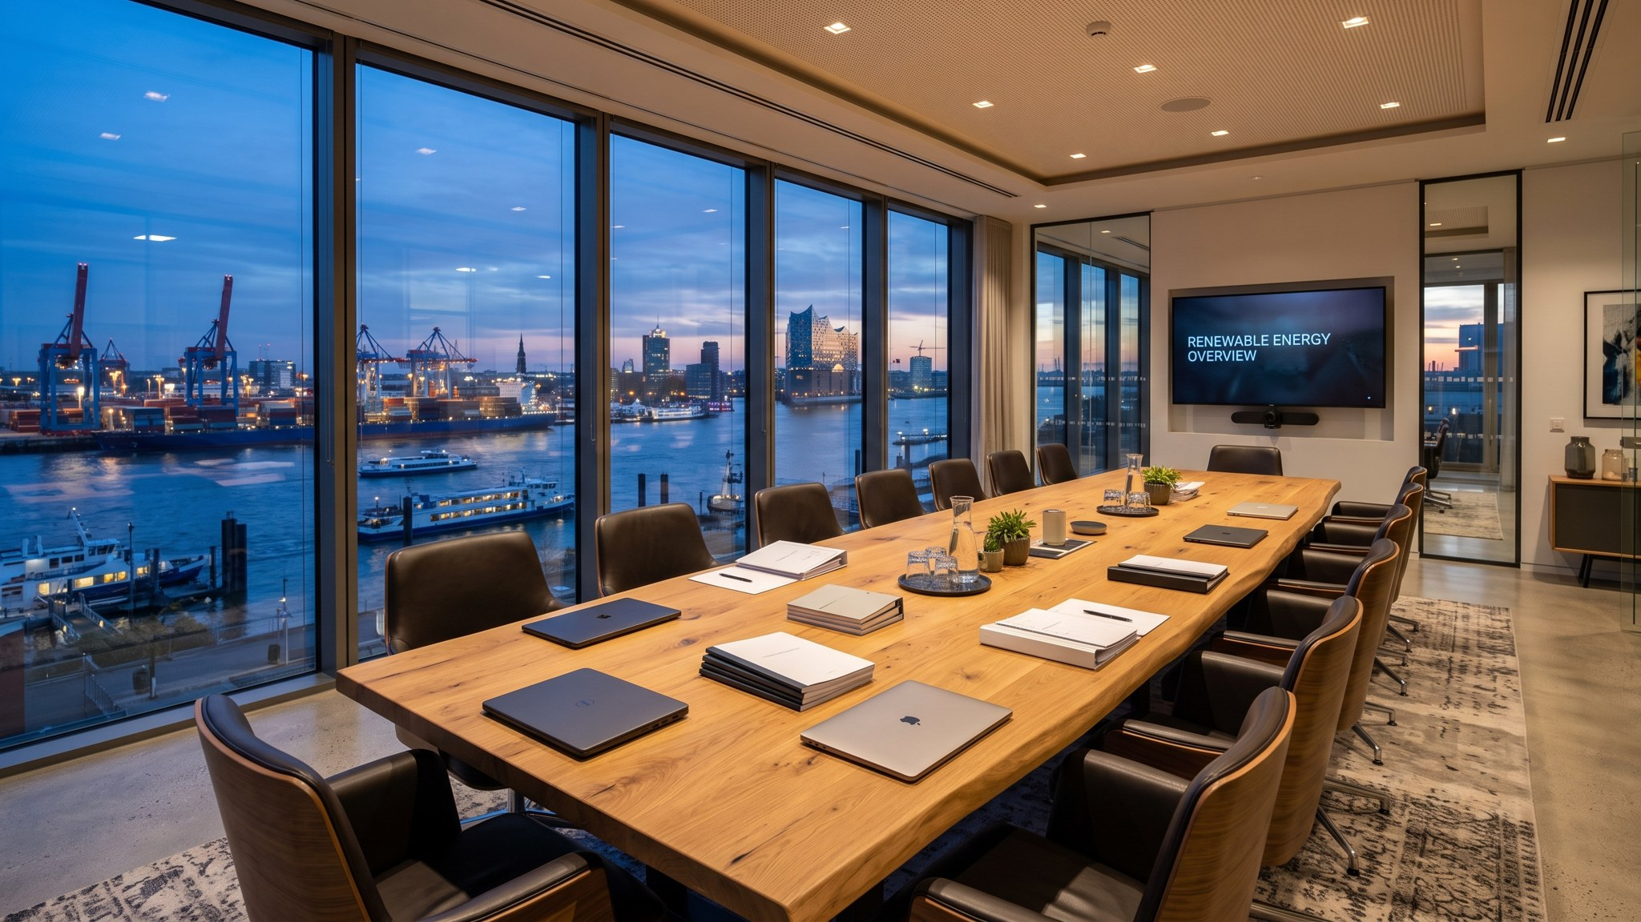
WEYLAND ENERGY
Harrow Bay Offshore Wind
Final investment decision · Supervisory Board · 12 February 2026

Slide 2
The project at a glance
480 MW
1.9 TWh
EUR 1.62 bn
Jun 2028
40 × Halden HTS-12
per year (P50)
total capex
COD
• 38 km off the coast of Harrow Bay, water depth 28–36 m
• 2 × 220 kV export cables of 62 km to Harrow Bay East
WEYLAND ENERGY · Harrow Bay – Final Investment Decision
2

Slide 3
Capex budget
Package | EUR m
Turbines | 575
Foundations | 268
Cables | 232
Offshore substation | 196
Installation, vessels & logistics | 122
Onshore & grid | 61
Development, owner's costs & insurance | 111
Contingency | 55
Total | 1,620
WEYLAND ENERGY · Harrow Bay – Final Investment Decision
3

Slide 4
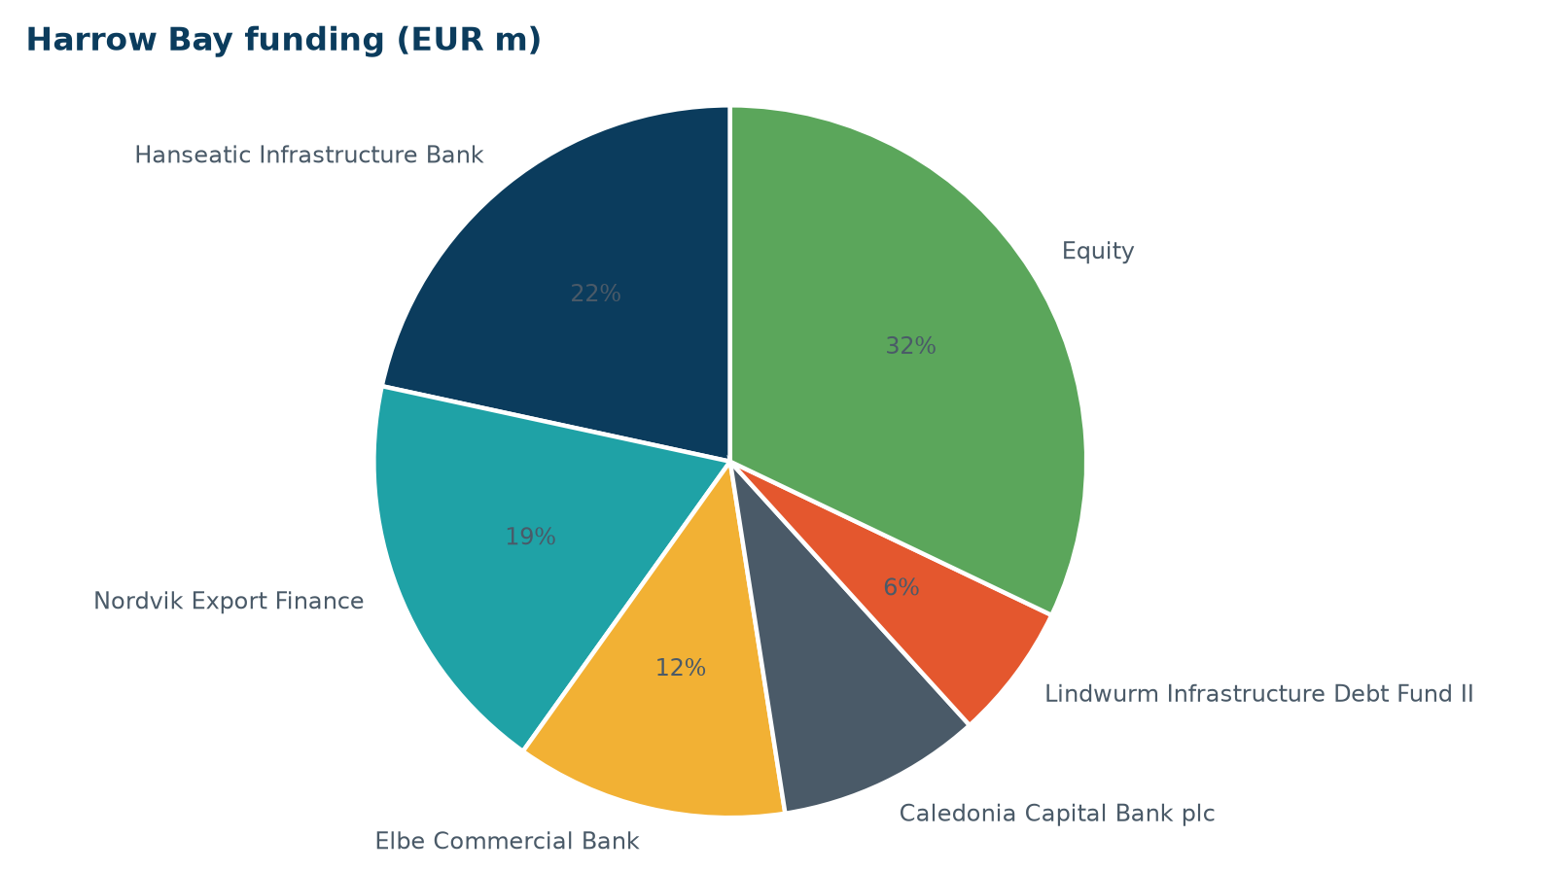
Financing structure
• EUR 1,100 m senior debt, 5 lenders
• Hanseatic Infrastructure Bank as MLA
• EUR 520 m equity, equity first
• 85 % of interest hedged at 2.74 %
WEYLAND ENERGY · Harrow Bay – Final Investment Decision
4

Slide 5
Returns
Metric | P50 | P90
Project IRR | 7.6 % | 6.4 %
Equity IRR | 10.4 % | 8.1 %
Min. DSCR | 1.40x | 1.30x
LCOE (EUR/MWh) | 71 | 79
WEYLAND ENERGY · Harrow Bay – Final Investment Decision
5
Notes:
Hurdle rate for contracted offshore wind is 9.0 %. Mention the PPA with Arcturus – term sheet agreed, signing planned for May.

Slide 6
Schedule to COD
• Apr 2026 – first monopile (MV Sea Atlas)
• Aug 2026 – offshore substation topside
• Q4 2026 – export cable lay
• Mar 2027 – first turbine
• Sep 2027 – first power
• Jun 2028 – COD
WEYLAND ENERGY · Harrow Bay – Final Investment Decision
6

Slide 7
Key risks
• Export cable manufacturing – single factory at Severn Subsea Cables
• Weather downtime – P75 allowance
• Marine mammals – bubble curtains, seasonal restrictions
• Interest rates – hedged at FC
WEYLAND ENERGY · Harrow Bay – Final Investment Decision
7
Notes:
Gareth will ask about the cables. 14 weeks float to COD, LDs under WE-CON-2025-031.

Slide 8
WEYLAND ENERGY
We recommend approving the FID
Clean power, built to last.

